Slide 1
Use case diagrams
Jason Quibilan
Bro Troy Tuckett
CIT 360

Slide 2
Definition
A Use case diagram is a behavioral UML diagram type and frequently used to analyze various systems. They enable you to visualize the different types of roles in a system and how those roles interact with the system.

Slide 3
Benefits
Use cases is a powerful technique for the elicitation and documentation of black-box functional requirements.
Because, use cases are easy to understand and provide an excellent way for communicating with customers and users as they are written in natural language.
Use cases can help manage the complexity of large projects by partitioning the problem into major user features (i.e., use cases) and by specifying applications from the users' perspective.
A use case scenario, often represented by a sequence diagram, involves the collaboration of multiple objects and classes, use cases help identify the messages (operations and the information or data required - parameters) that glue the objects and classes together.
Use cases provide a good basis to link between the verification of the higher-level models (i.e. interaction between actors and a set of collaborative objects), and subsequently, for the validation of the functional requirements (i.e. blueprint of white-box test).
Use case driven approach provides an traceable links for project tracking in which the key development activities such as the use cases implemented, tested, and delivered fulfilling the goals and objectives from the user point of views.

Slide 4

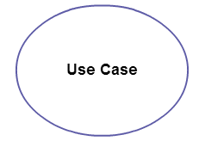
Use case diagram objects
Actor
Actor in a use case diagram is any entity that performs a role in one given system. This could be a person, organization or an external system and usually drawn as a stick figure
Use case
A use case represents a function or an action within the system. It’s drawn as an oval and named with the function.

Slide 5
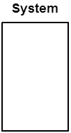
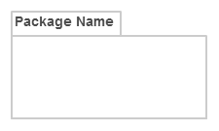
Use case diagram objects
System
The system is used to define the scope of the use case and drawn as a rectangle. This an optional element but useful when you’re visualizing large systems. For example, you can create all the use cases and then use the system object to define the scope covered by your project. Or you can even use it to show the different areas covered in different releases.
Package
The package is another optional element that is extremely useful in complex diagrams. Similar to class diagrams, packages are used to group together use cases.

Slide 6
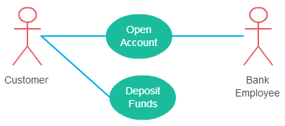
Relationships in use case diagrams
Association between an actor and a use case
An actor must be associated with at least one use case.
An actor can be associated with multiple use cases.
Multiple actors can be associated with a single use case.

Slide 7
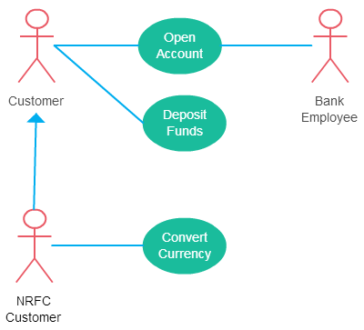
Relationships in use case diagrams
Generalization of an Actor
one actor can inherit the role of the other actor. The descendant inherits all the use cases of the ancestor. The descendant has one or more use cases that are specific to that role. Let’s expand the previous use case diagram to show the generalization of an actor.

Slide 8
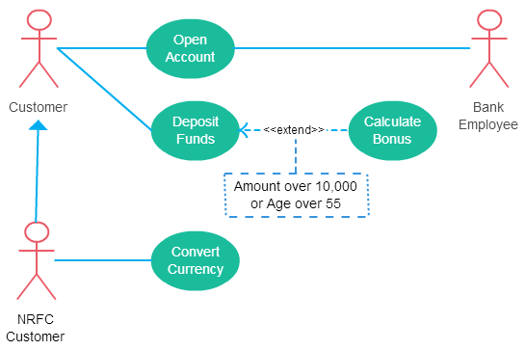
Relationships in use case diagrams
Extend Relationship Between Two Use Cases
The extending use case is dependent on the extended (base) use case. In the diagram the “Calculate Bonus” use case doesn’t make much sense without the “Deposit Funds” use case.
The extending use case is usually optional and can be triggered conditionally. In the diagram, you can see that the extending use case is triggered only for deposits over 10,000 or when the age is over 55.
The extended (base) use case must be meaningful on its own. This means it should be independent and must not rely on the behavior of the extending use case.

Slide 9
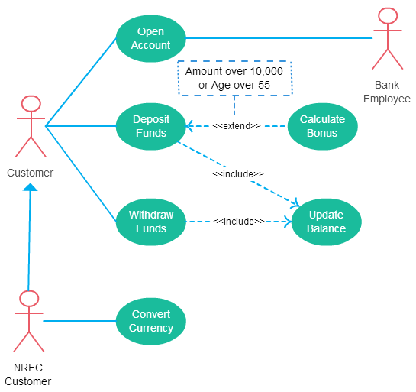
Relationships in use case diagrams
Include Relationship Between Two Use Cases
shows that the behavior of the included use case is part of the including (base) use case. The main reason for this is to reuse the common actions across multiple use cases. In some situations, this is done to simplify complex behaviors.
The base use case is incomplete without the included use case.
The included use case is mandatory and not optional.

Slide 10
Relationships in use case diagrams
Generalization of a Use Case
This is similar to the generalization of an actor. The behavior of the ancestor is inherited by the descendant. This is used when there is common behavior between two use cases and also specialized behavior specific to each use case.
I.e., in the previous diagrams, there might be a use case called “pay bills”. This can be generalized to “Pay by Credit card”, “pay by bank balance” etc.

Slide 11
Works cited
https://creately.com/blog/diagrams/use-case-diagram-tutorial/
http://csis.pace.edu/~marchese/CS389/L9/Use%20Case%20Diagrams.pdf
https://online.visual-paradigm.com/tutorials/use-case-diagram-tutorial/

